Slide 1

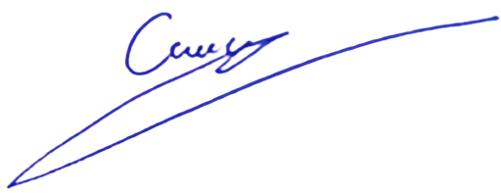
GIẤY CHỨNG NHẬN
CERTIFICATE OF COMPLETION
•
• Cuong Le Van (Mr.)
• Google Developer Students Clubs HCMUTE Lead
•
Notes:
Cuong Le Van (Mr.)
Google Developer Student Clubs HCMUTE Lead

Slide 2
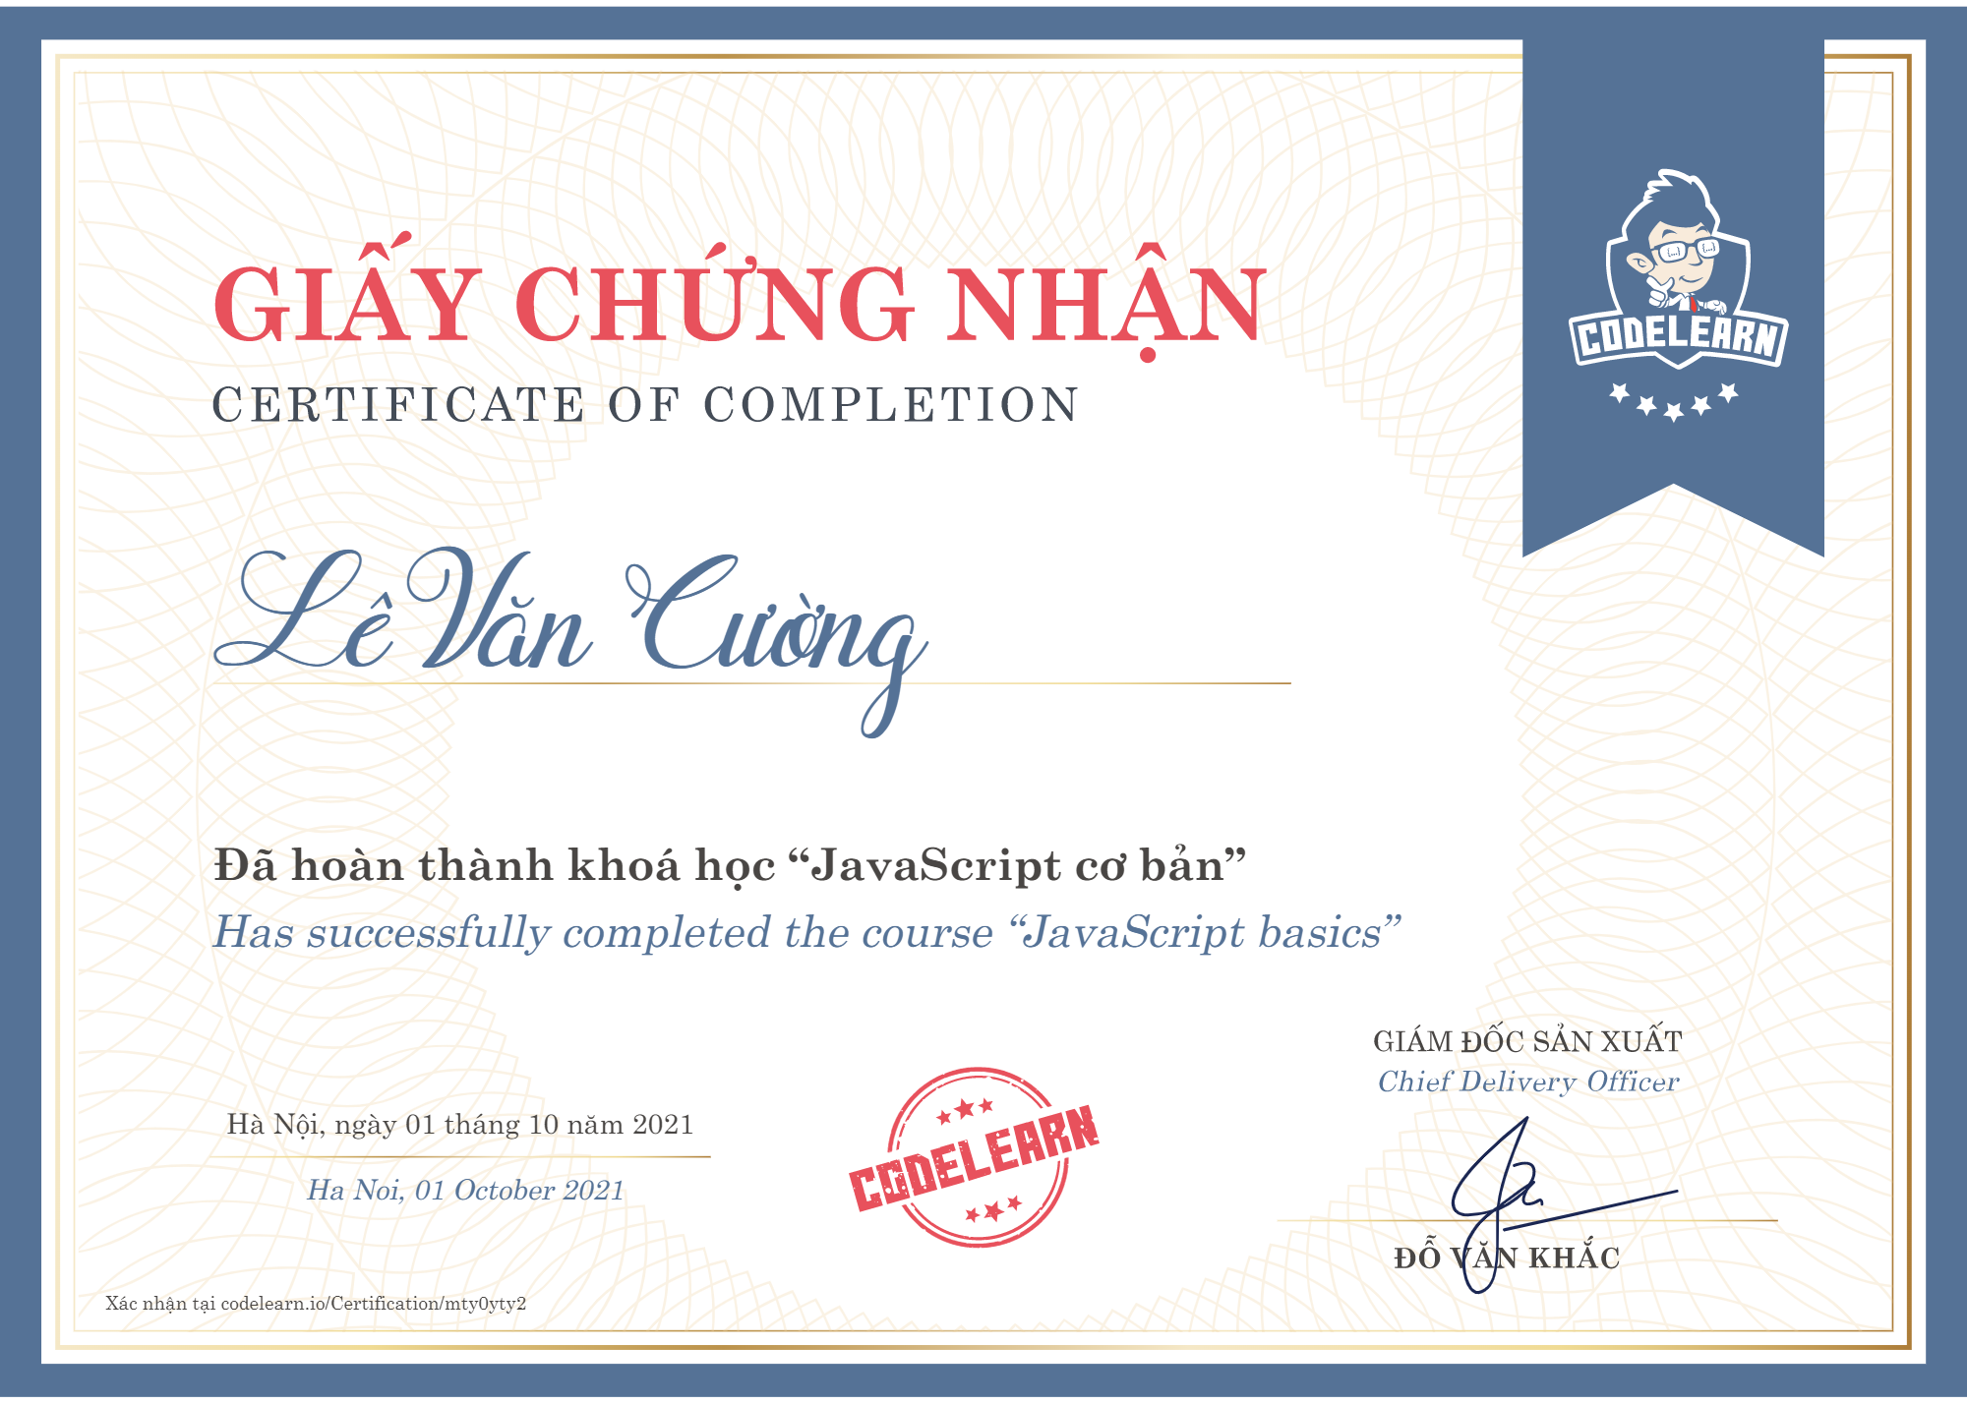

GIẤY CHỨNG NHẬN
CERFITICATE OF COMPLETION
GIÁM ĐỐC SẢN XUẤT
Chief Delivery Officer
Notes:
Chief Delivery Officer

